Slide 1
DS8007 Project Fire Incidents in Toronto 2011-2018
Faiza Noor

Slide 2
Agenda
Introduction
Data Description
Research Questions
EDA and Result

Slide 3


Introduction
My presentation will be highlighting insights on Toronto fire incidents. Exploring visualizations of the data can help us better gather multi-factor determinants of common fire issues, correlations between casualties from fire and other factors, and impacts such as the kind damage and costs that arise from them

Slide 4
Data Description and Pre-Processing

Slide 5
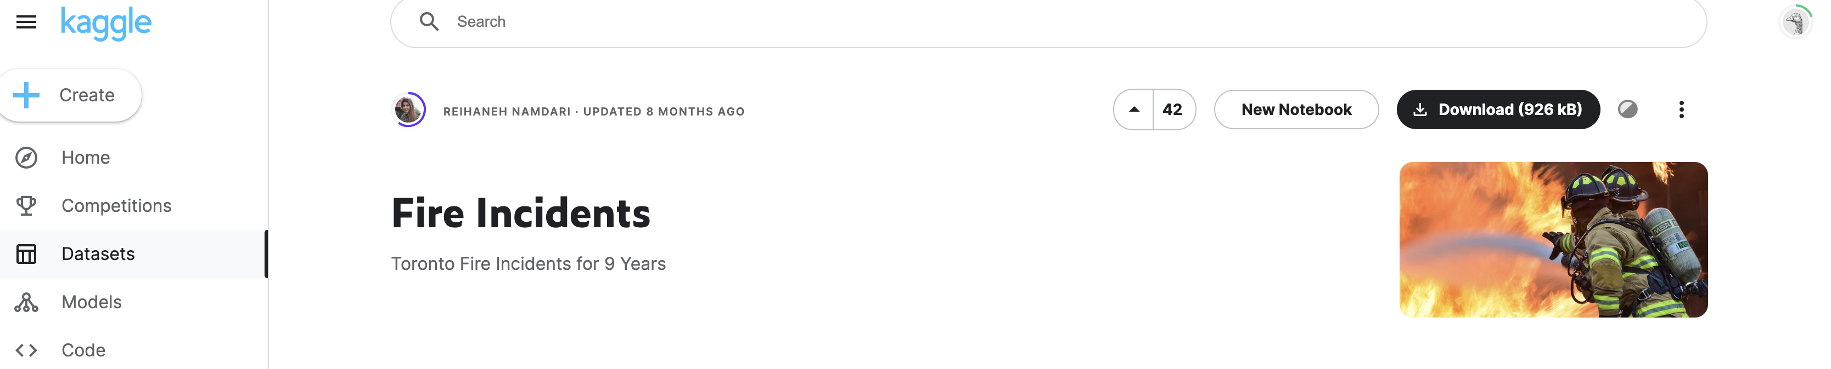
Area_of_Origin - Categorical Business_Impact - Categorical Civilian_Casualties - Numeric (Continuous) Count_of_Persons_Rescued - Numeric (Continuous) Estimated_Dollar_Loss - - Numeric (Continuous) Estimated_Number_Of_Persons_Displaced - Numeric (Continuous) Ext_agent_app_or_defer_time - Numeric (Timestamp) Extent_Of_Fire - Categorical Fire_Alarm_System_Impact_on_Evacuation - Categorical Fire_Alarm_System_Operation - Categorical Fire_Alarm_System_Presence - Categorical Fire_Under_Control_Time - Numeric (Timestamp) Ignition_Source - Categorical Incident_Station_Area - Numeric (Discrete) Incident_Ward - Numeric (Discrete) Last_TFS_Unit_Clear_Time - Numeric (Timestamp) Latitude - Numeric (Location Coordinates) Longitude - Numeric (Location Coordinate) Material_First_Ignited - Categorical Method_Of_Fire_Control - Categorical Possible_Cause - Categorical Property_Use - Categorical Smoke_Alarm_at_Fire_Origin_Alarm_Failure - Categorical Smoke_Alarm_at_Fire_Origin_Alarm_Type - Categorical Status_of_Fire_On_Arrival - Categorical - Categorical TFS_Alarm_Time - Numeric (Timestamp) TFS_Arrival_Time - Numeric (Timestamp)
The "Toronto Fire Incident" dataset from Kaggle consists of 27 columns, over 11,000 rows, highlighting the specifications of each fire incident that occurred and was attended to by the Toronto fire departments from the years 2011-2018

Slide 6
Data Pre-processing
Pre-processing Steps | Example
Replace nan values | df["Incident_Ward"].fillna(-1, inplace=True)
Convert dataframe data types to correct type | df = df.astype({"Area_of_Origin":"string”})
Refine categorical variables | df["Area_of_Origin"].nunique() df["Area_of_Origin"].value_counts()
Feature Engineering | df['Year'] = df['TFS_Alarm_Time'].dt.year

Slide 7
Research Questions:
What are the areas of origin where fires most occur?
What are the top determinants (probable cause) of residential fire in Toronto over the 9 years?
When do casualties most occur?
Correlations between casualties and other factors

Slide 8

EDA and Results
Notes:
Okay so let’s dive intp the EDA and results

Slide 9
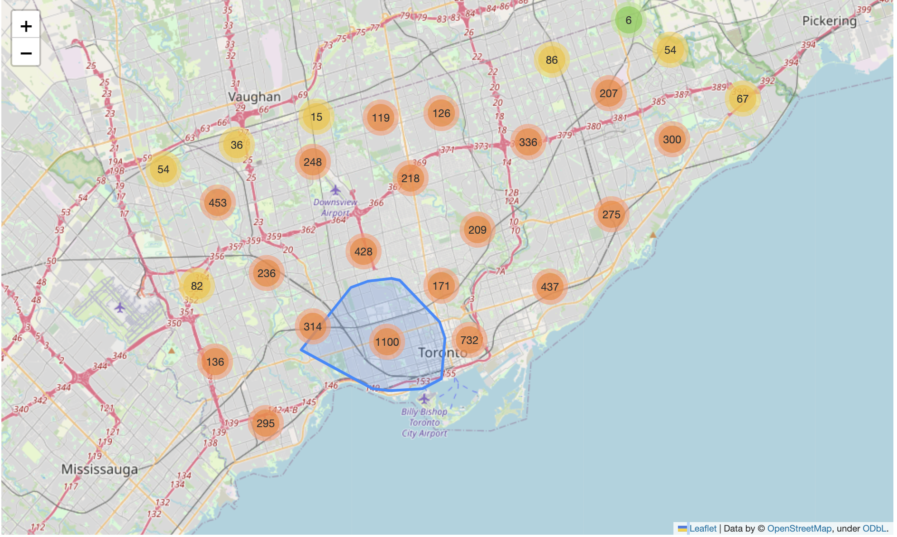
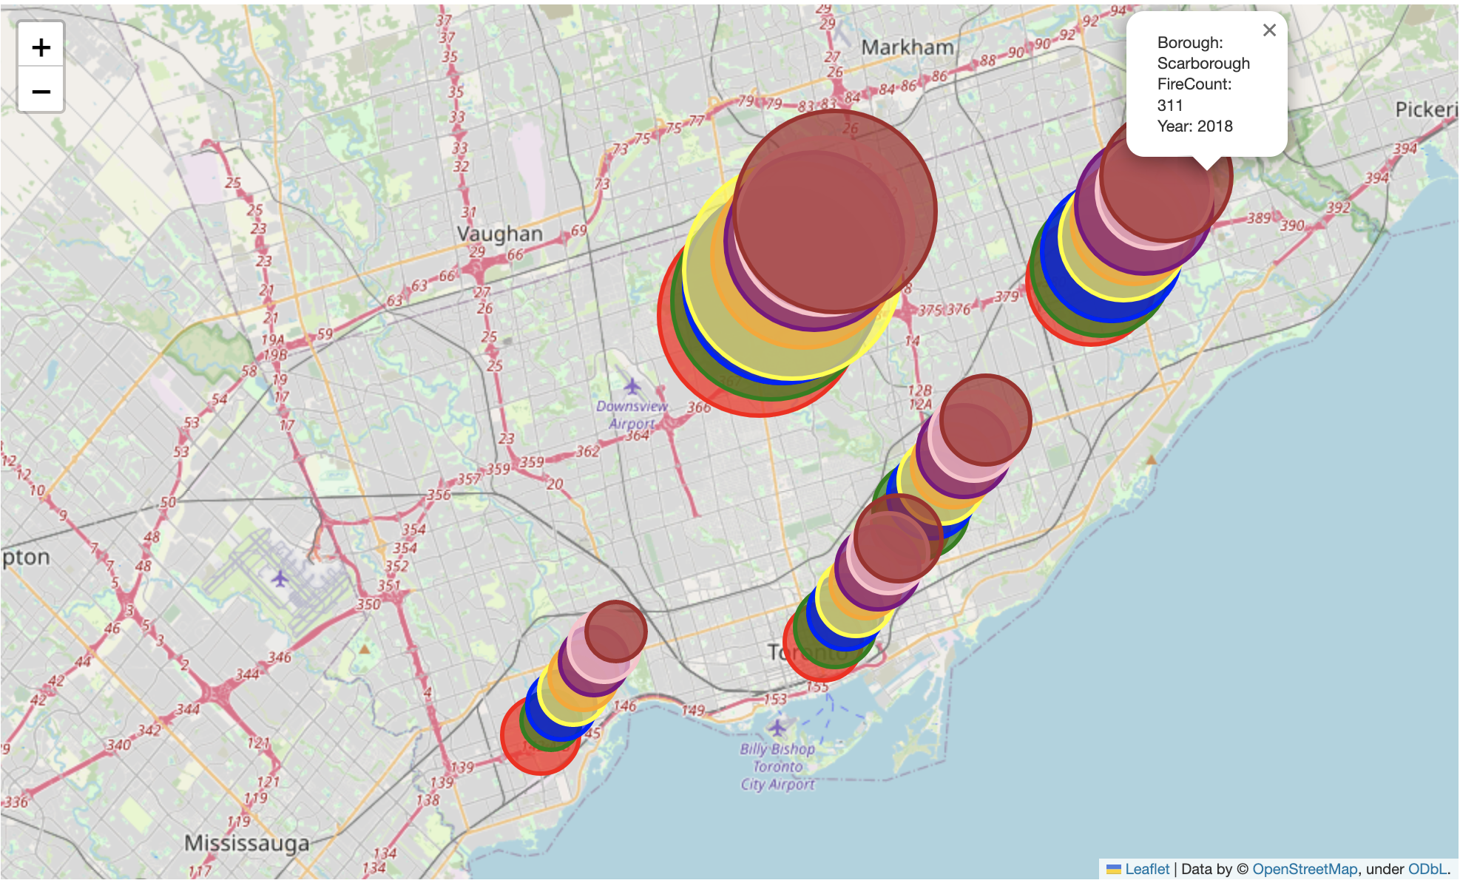
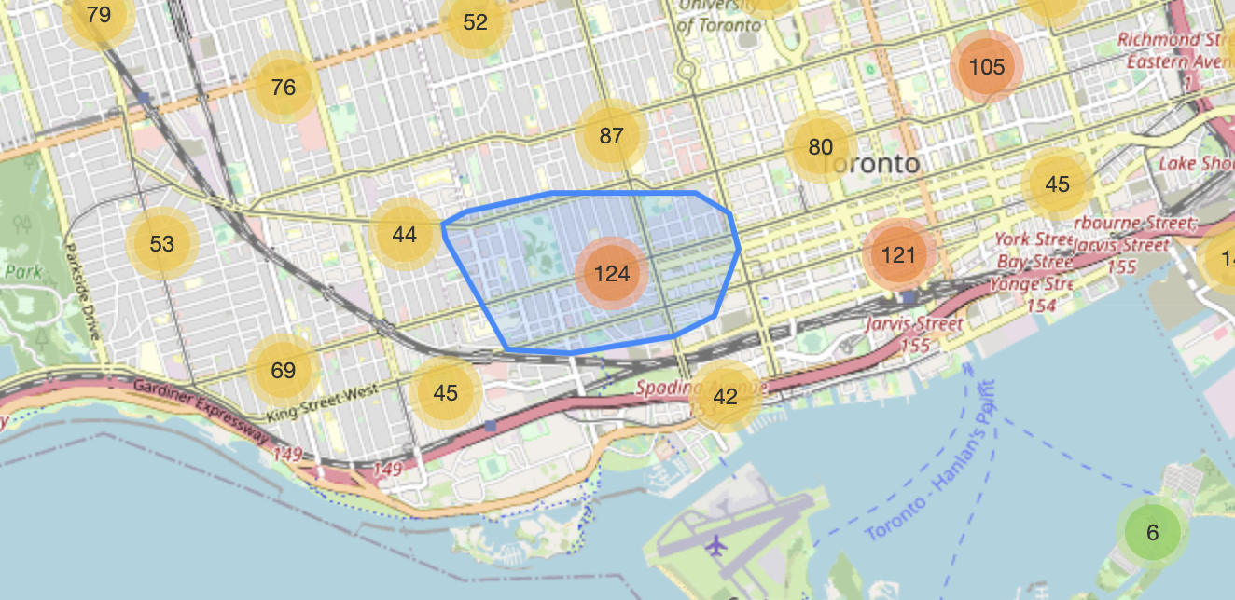
Number of fire incidents per Toronto’s 6 Boroughs: 1. Scarborough
5. The Junction (combined with North York in the visualization)
2. North York
3. East York
4. Etobicoke
6. Old Toronto
Slight decrease in incidents over the last 2 years (2017/2018) but mostly consistent in total count of incidents per Borough

Slide 10
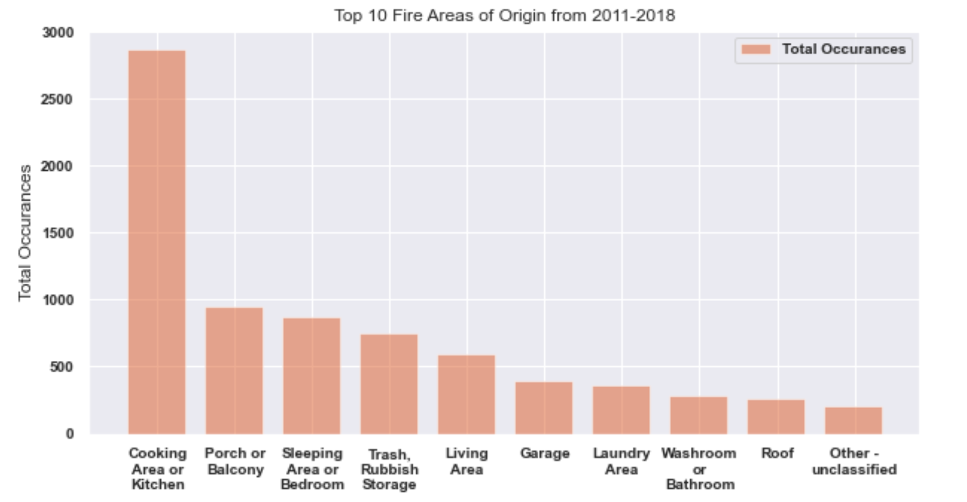
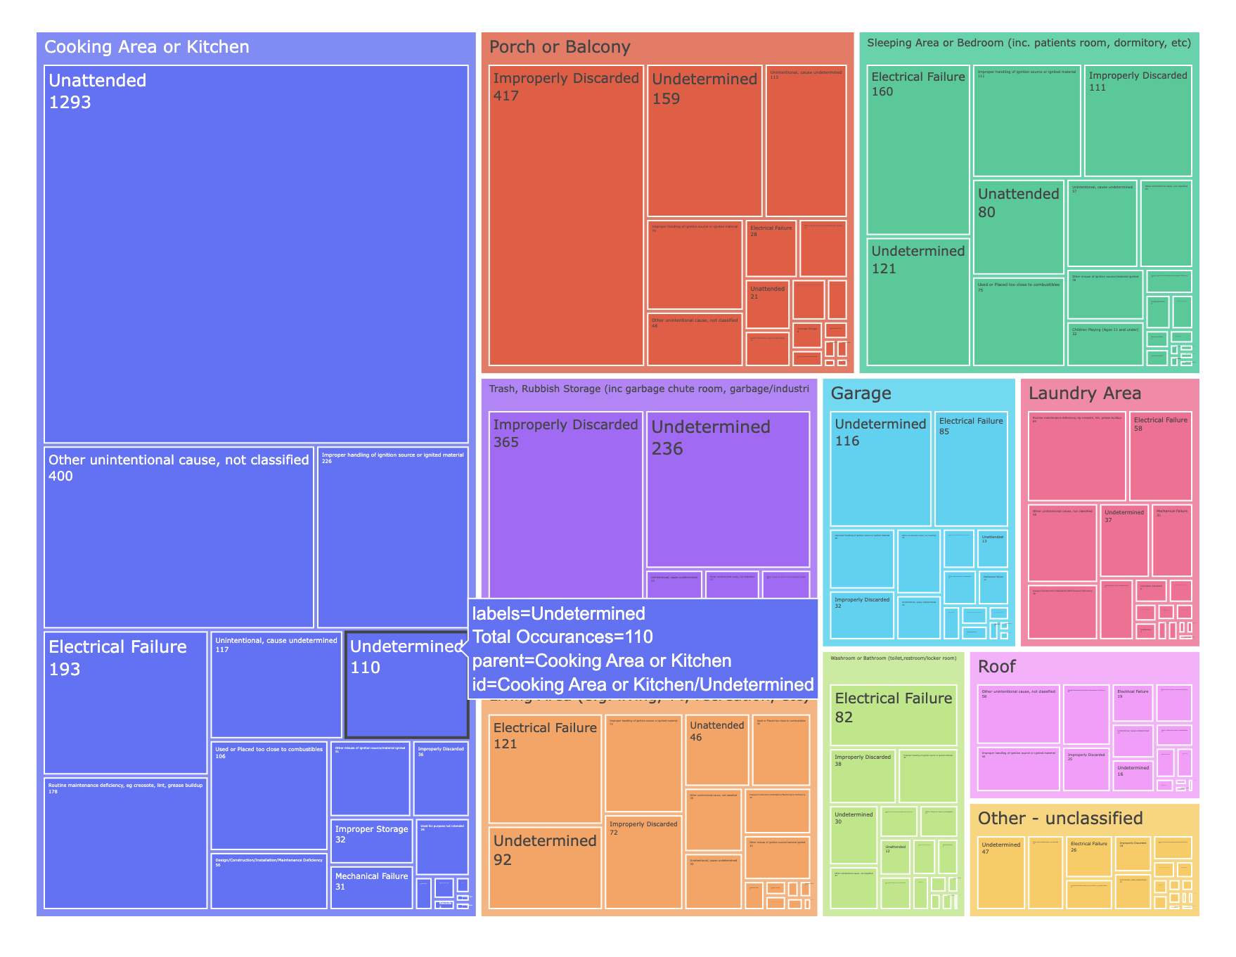
Leading cause for porch or balcony fires is improperly discarded items
Most fires originated in cooking area or kitchen. The common cause is leaving items unattended

Slide 11
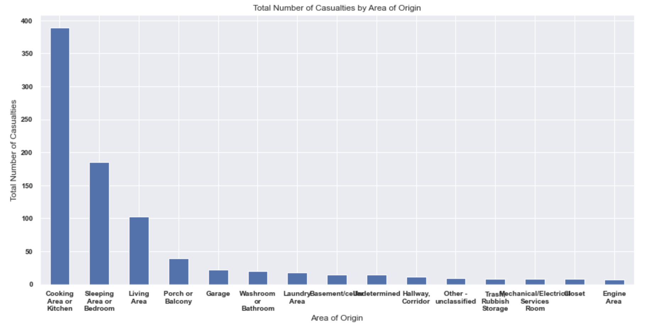
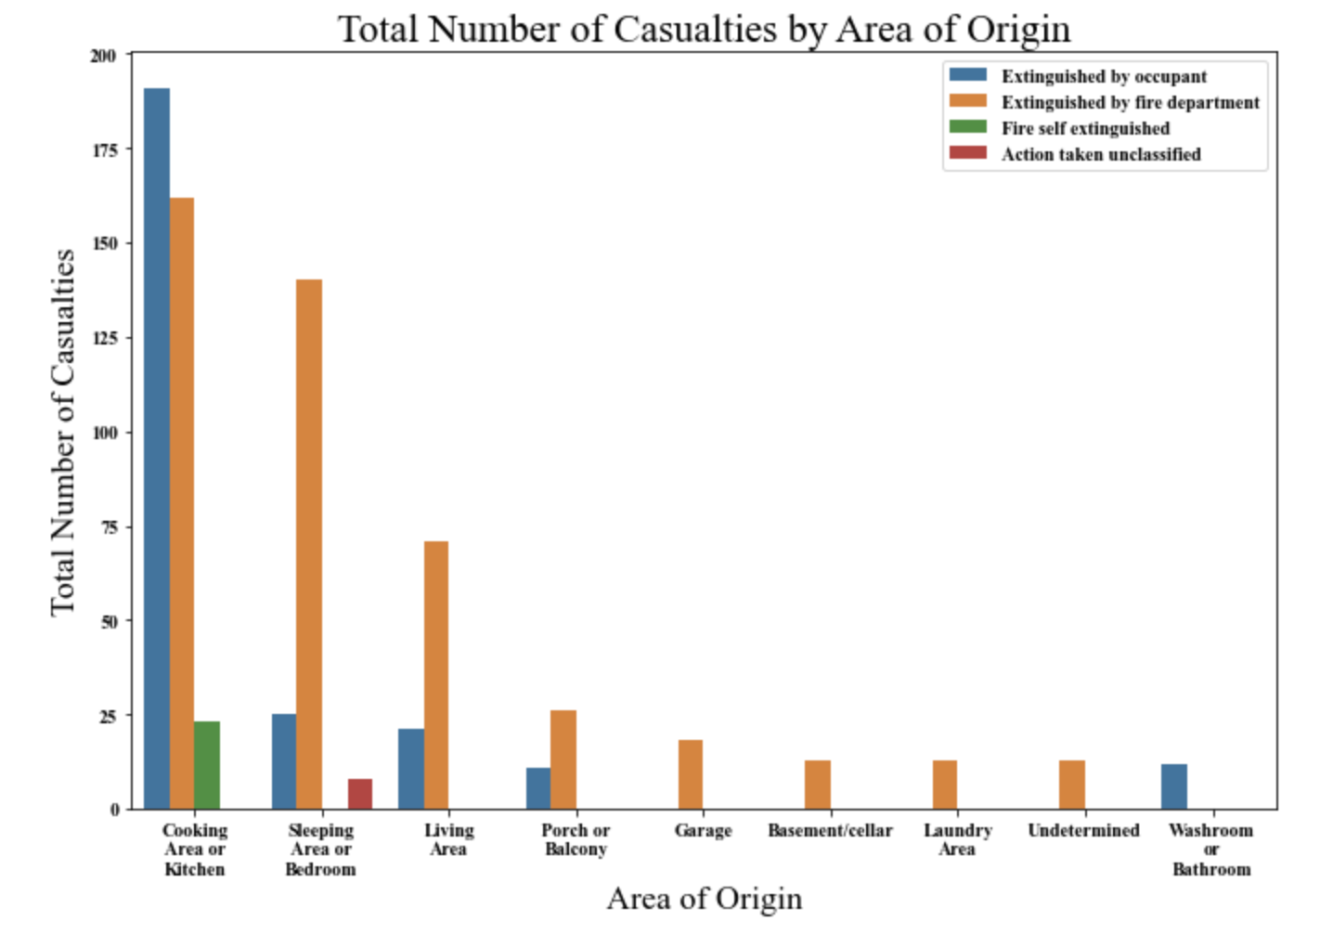
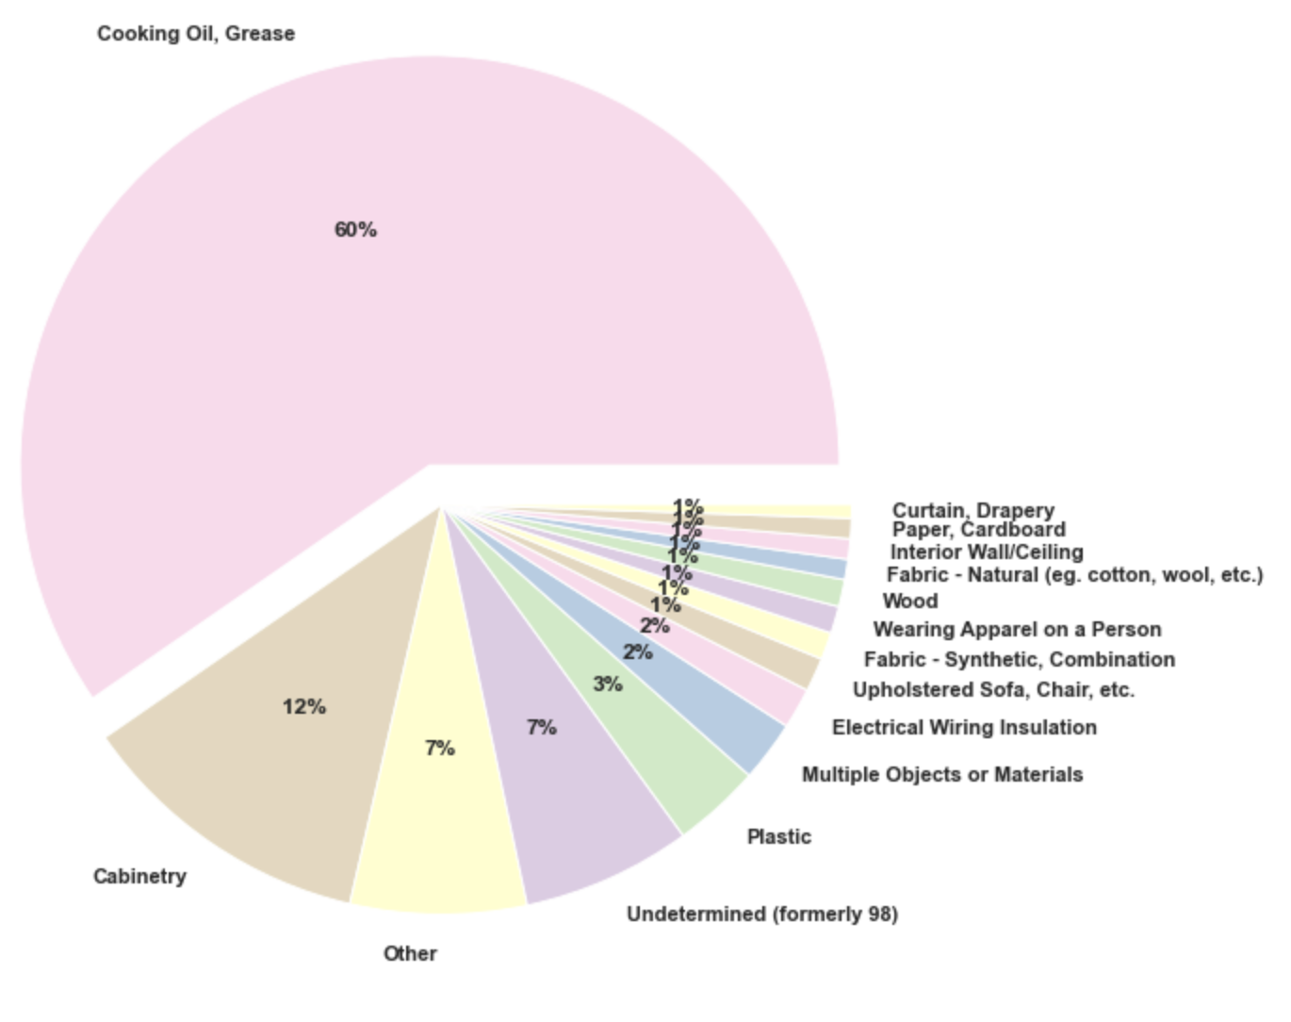
Diving Deeper into Cooking Area or Kitchen
Cooking oil is the most common material first ignited in kitchen fires
More casualties are caused when fire is attempted to be extinguished by occupant

Slide 12
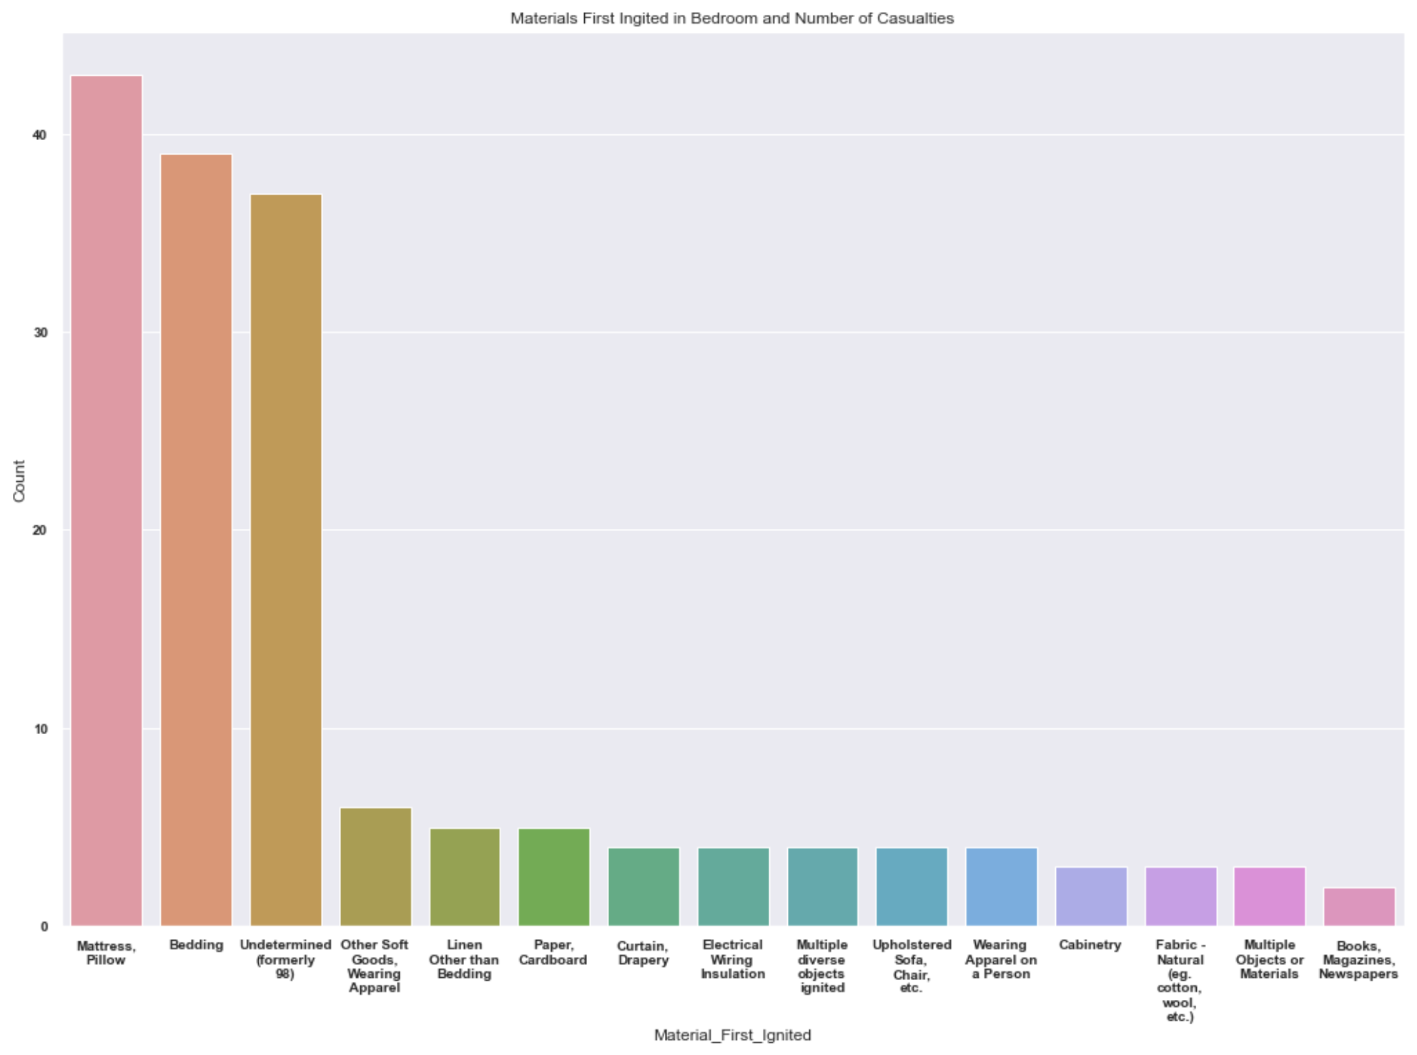
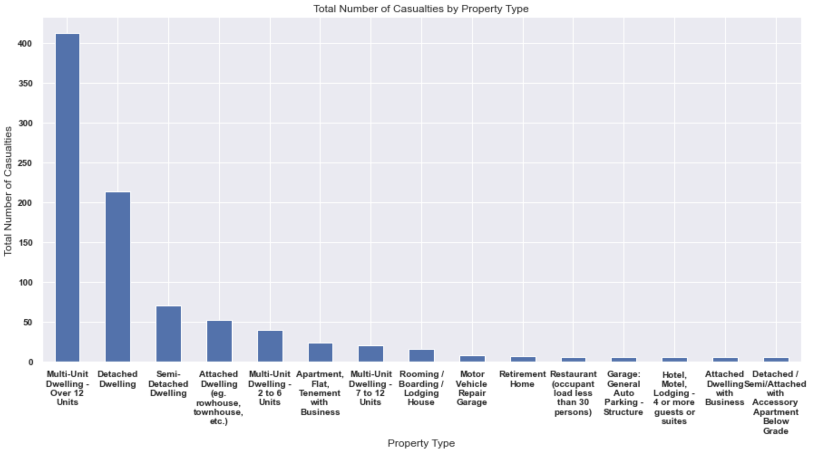
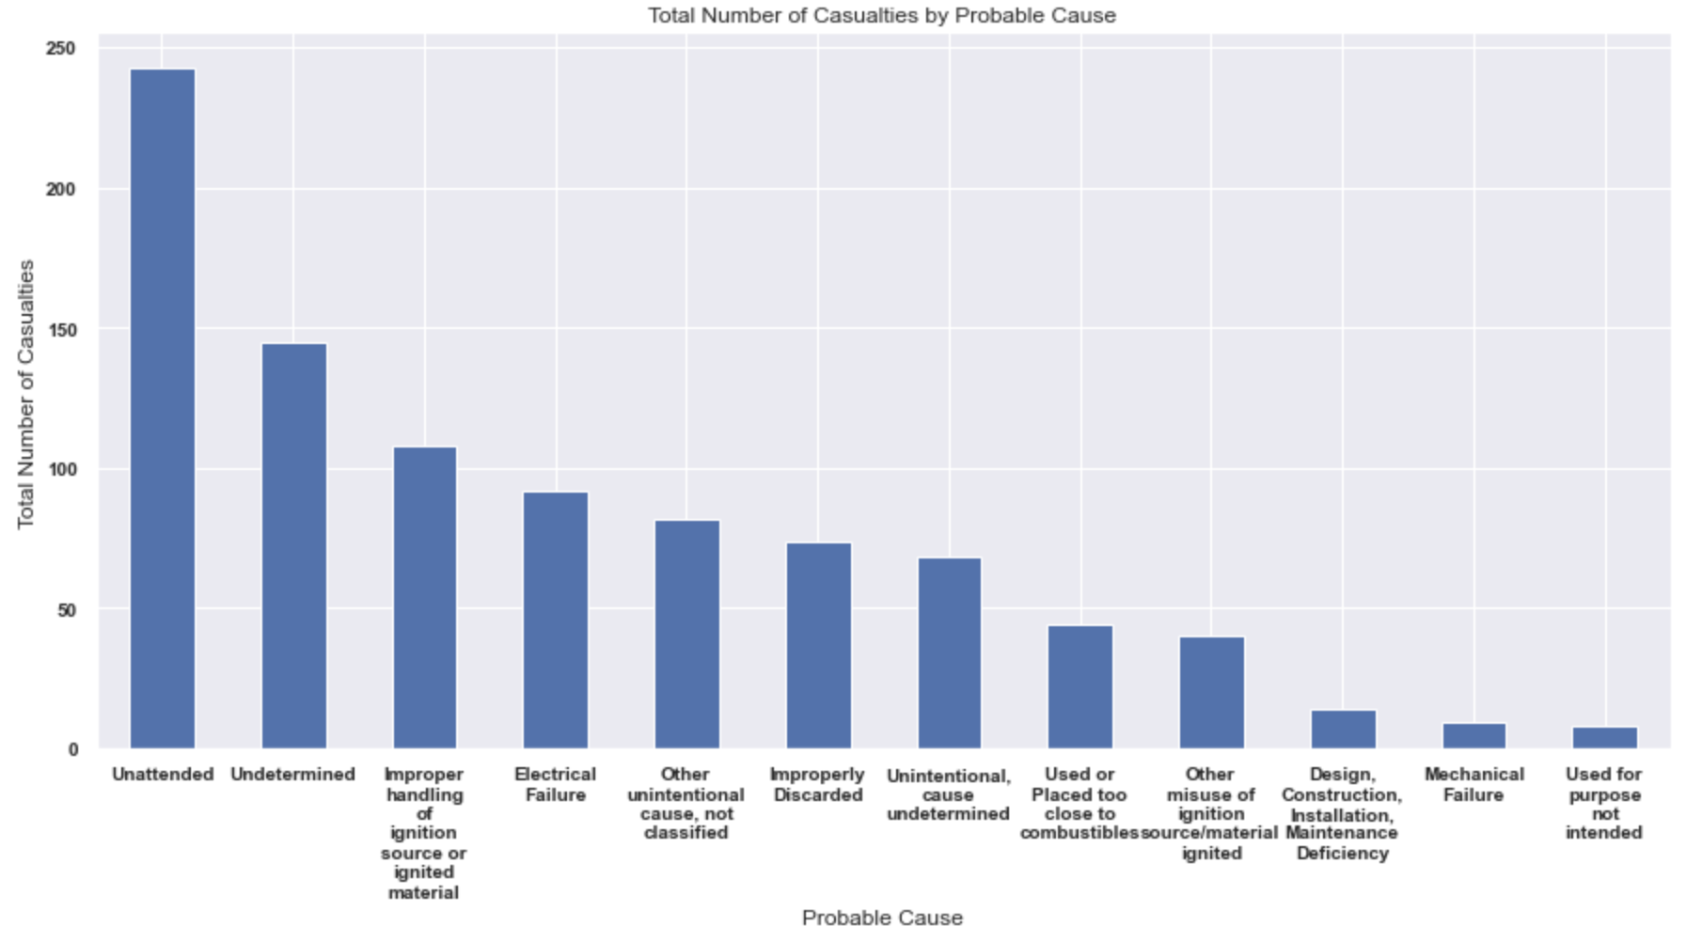
Mattress/Pillow is the most common material first ignited in bedroom fire, which causes more casualties than other items in the bedroom
Multi-Unit Dwellings seem to be most dangerous property types
The most common causes in fire casualties is inattentiveness and improper handling of ignition sources

Slide 13
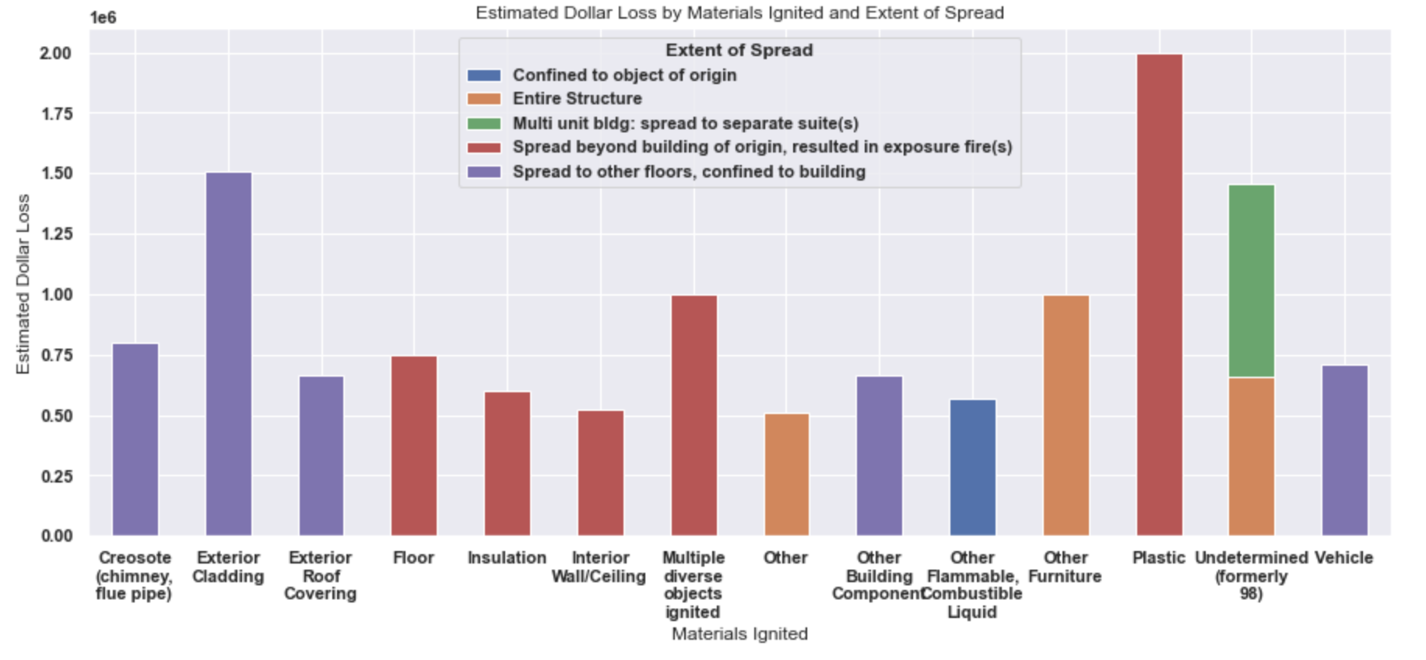
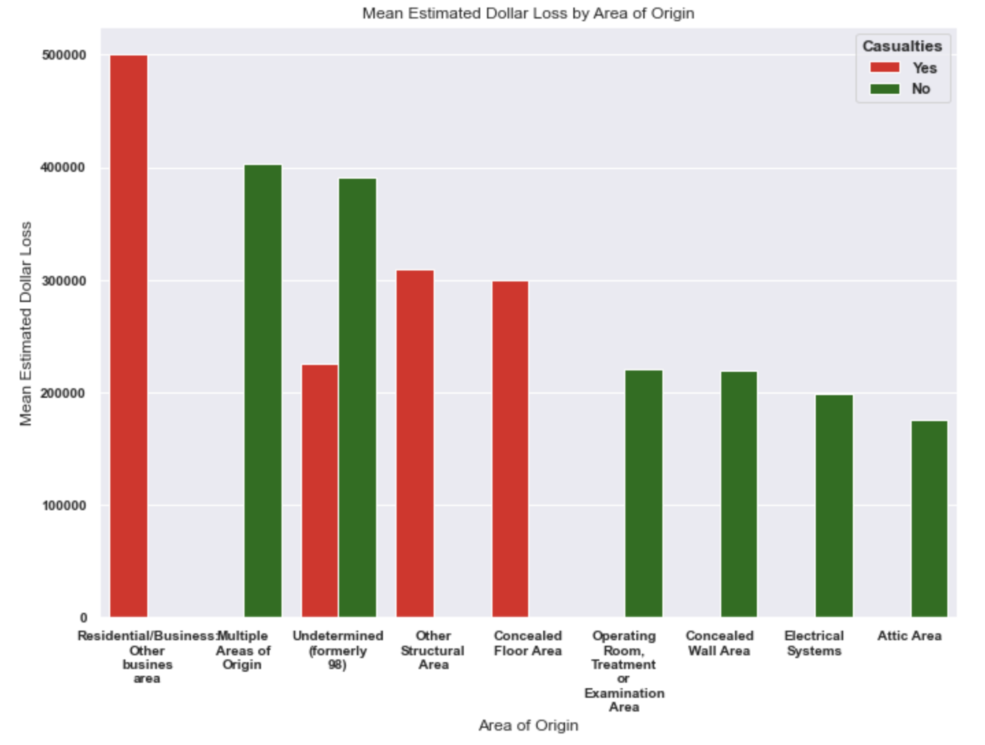
Plastic both spreads the most, and most costly
Fire in residential and business areas have seen more casualties and highest dollar loss

Slide 14
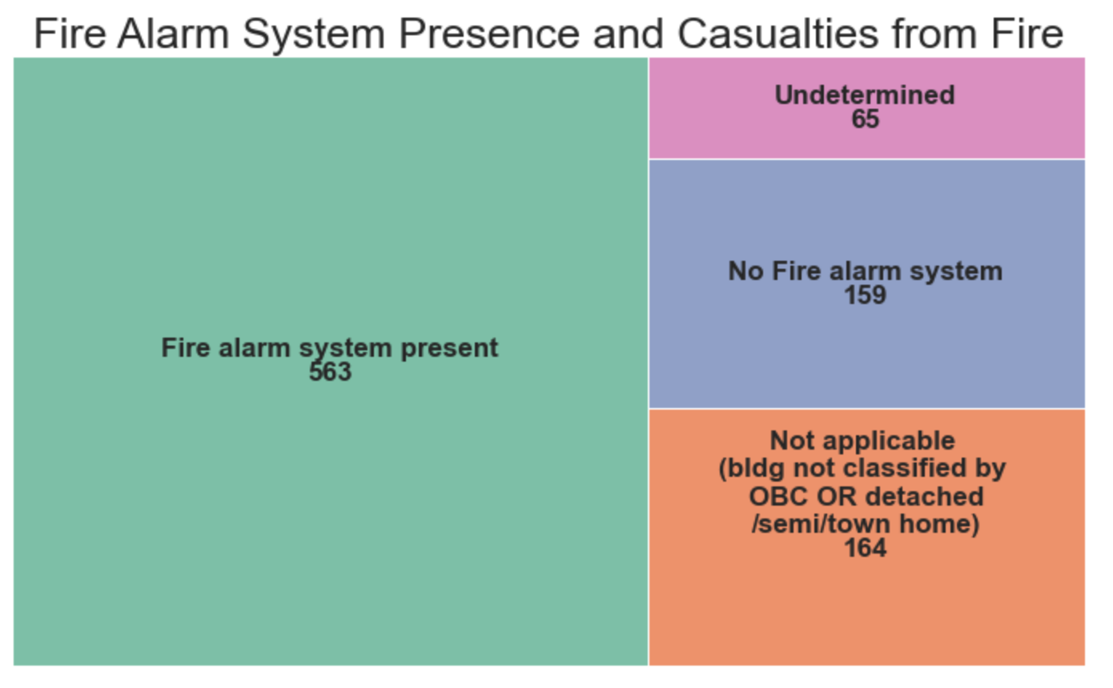
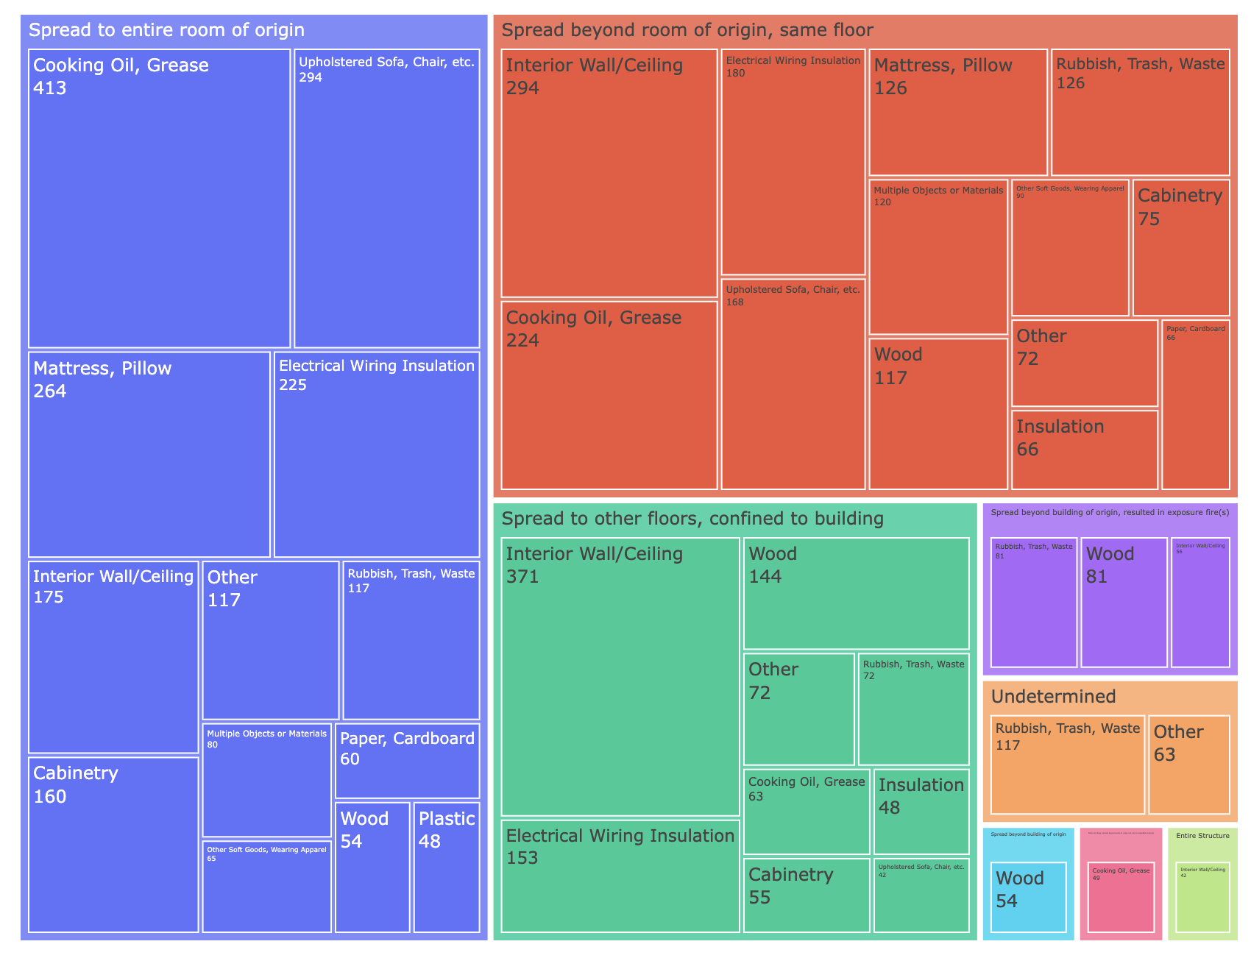
Fire alarm presence seem to have low impact on casualties
Common materials that cause to fire spread: Cooking Oil
Interior Wall
Wood

Slide 15
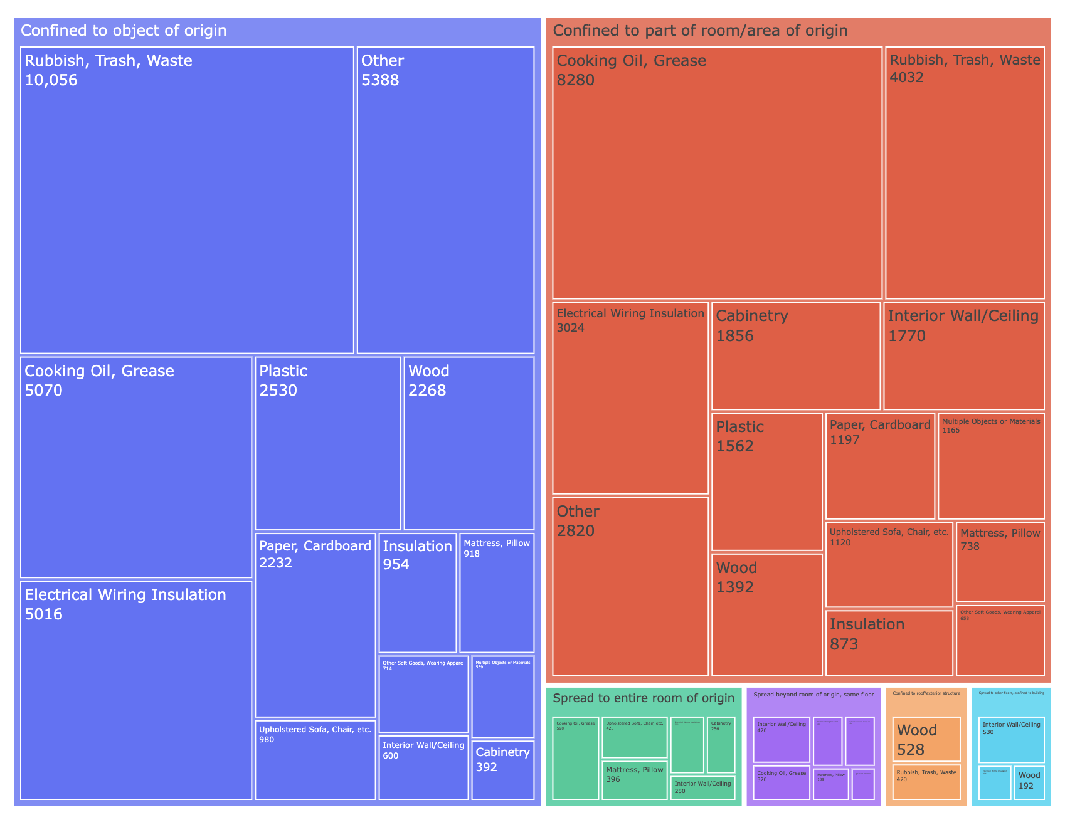

Slide 16
Thank you
Questions?

